Slide 1
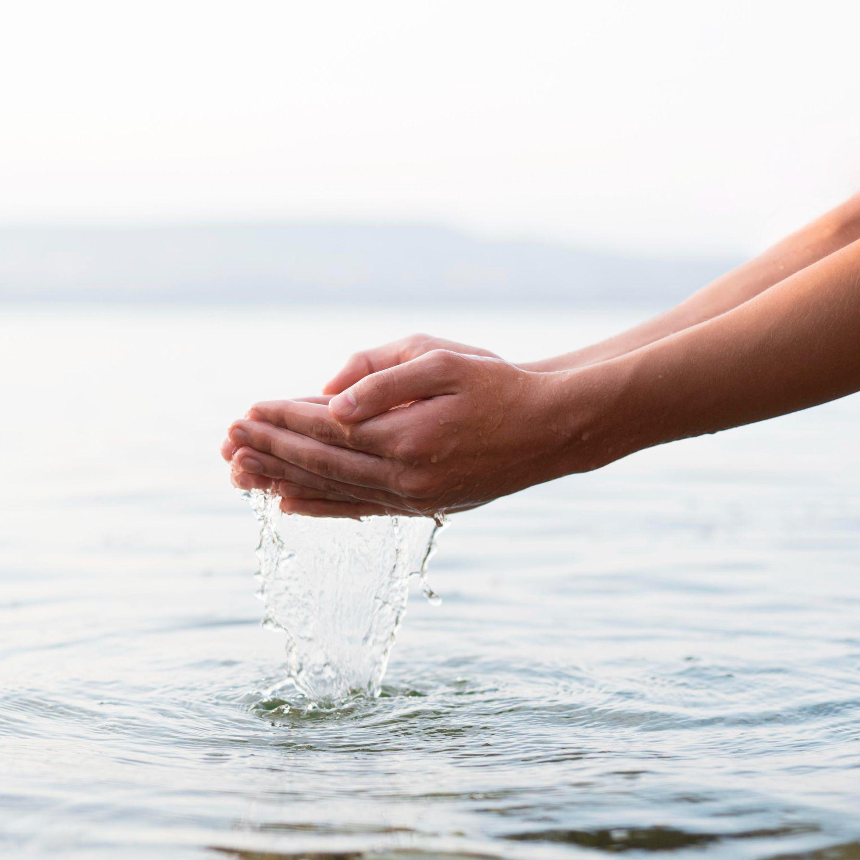
Water Potability
Project :
Quantum & AI
for CLIMATE CHALLENGE
by
Karan islur
Shreya Rajpal
Amit Modhwadia
Saiyam Sakhuja

Slide 2

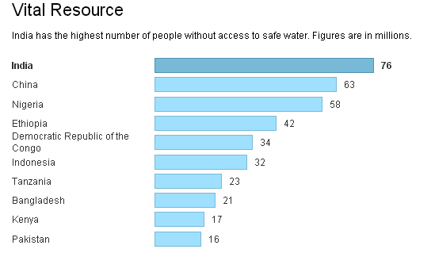
Why Water Potability ?
Focus:
The intersection of climate change and water quality.
Issue:
Rising global temperatures lead to more severe droughts and floods, impacting water availability and safety.
Challenge:
Predicting water potability under changing environmental conditions using advanced AI and quantum computing techniques.
Water Potability:
Ensuring safe drinking water is critical as environmental factors like pH levels, contaminants, and hardness are influenced by changing climate conditions.
Notes:
https://www.facebook.com/cnnnews18/photos/just-how-serious-is-indias-portable-water-crisis-check-out-this-infographic/10157523456029202/
https://www.google.com/url?sa=i&url=https%3A%2F%2Fwww.kent.co.in%2Fblog%2F3-facts-about-drinking-water-in-india-why-a-water-purifier-is-a-must%2F&psig=AOvVaw19UcMLxp0qK5Lx5GE1xH2G&ust=1723729666722000&source=images&cd=vfe&opi=89978449&ved=0CBcQjhxqGAoTCJjW0cXP9IcDFQAAAAAdAAAAABCAAQ

Slide 3
Task - I
Water Quality Analysis Using
AI and Quantum Algorithms
Dataset Overview:
  We used a dataset comprising various water quality parameters such as pH, Hardness, Solids, Chloramines, Sulfate, Conductivity, Organic Carbon, Trihalomethanes, and Turbidity. These factors significantly influence water potability, which we aimed to predict using advanced algorithms.
ph | Hardness | Solids | Chloramines | Sulfate | Conductivity | Organic_ carbon | Trihalomethanes | Turbidity | Potability
 | 204.8905 | 20791.32 | 7.300212 | 368.5164 | 564.3087 | 10.37978 | 86.99097 | 2.963135 | 0
3.71608 | 129.4229 | 18630.06 | 6.635246 |  | 592.8854 | 15.18001 | 56.32908 | 4.500656 | 0

Slide 4
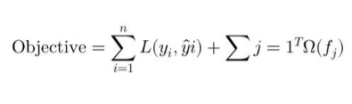
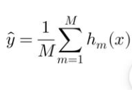
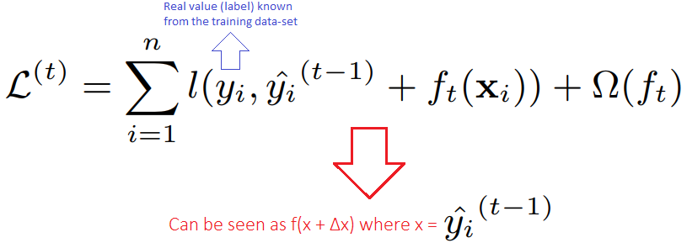

Water Quality Analysis Using
AI and Quantum Algorithms
Task - II
Light GBM
Bagging Classifier
AI Algorithms Applied:
XG Boost
Gradient Classifier

Slide 5
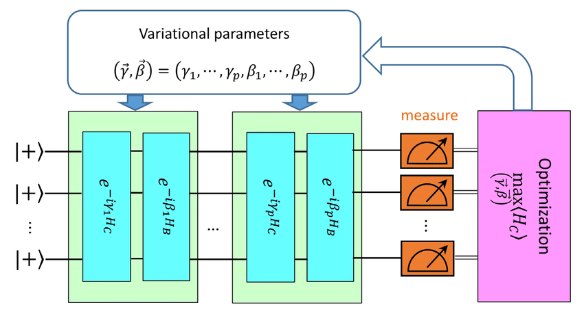
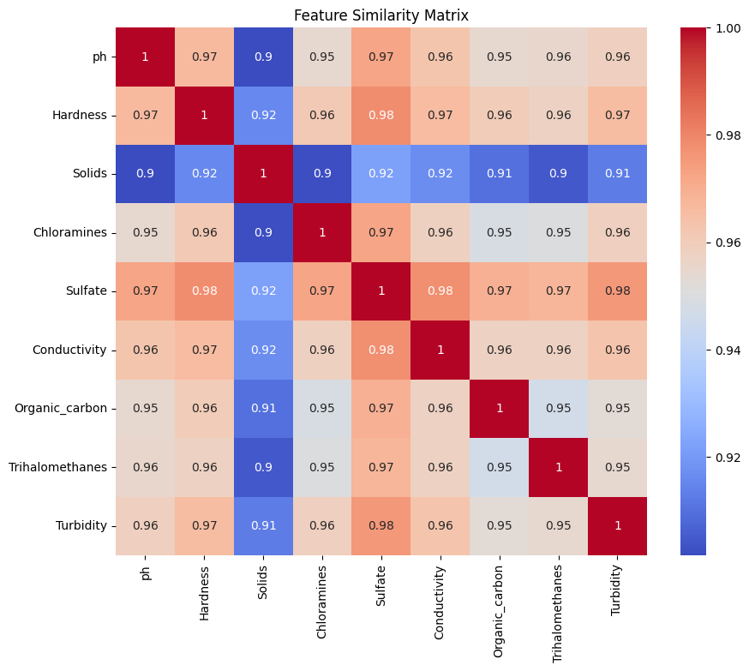
Water Quality Analysis Using
AI and Quantum Algorithms
Task - II
Quantum Algorithms:
  Quantum PCA: This method led to an improved performance, with the Quantum PCA + LightGBM model achieving a test accuracy of 70.9%.
  Quantum Approximate Optimization Algorithm (QAOA): QAOA is one of the most powerful optimization models where the dataset when parsed through the AI models is integrated to the QAOA algorithm with defined hyper parameters to generate a similarity matrix which is further simplified by minimizing the matrix and again generating the minimized confuse=ion matrix and similarity matrix.
  Quantum Support Vector Machines (QSVM): QSVMs used a quantum kernel to map data into a higher-dimensional quantum feature space
Notes:
https://www.google.com/url?sa=i&url=https%3A%2F%2Fwww.researchgate.net%2Ffigure%2FSchematic-diagram-of-hybrid-quantum-classical-QAOA-3-QAOA-based-scheme-for-solving-TSP_fig1_341047640&psig=AOvVaw1CsPg4LHak49CYER4HLQIu&ust=1723735041904000&source=images&cd=vfe&opi=89978449&ved=0CBcQjhxqFwoTCIjW7srj9IcDFQAAAAAdAAAAABAE

Slide 6
Metrics and Results
Algorithm | Test Accuracy | Test Recall | Test Precision
LightGBM Baseline | 0.684 | 0.373 | 0.628
Quantum Optimized LightGBM | 0.675 | 0.361 | 0.607
Quantum Transformed LightGBM | 0.628 | 0.000 | 0.000
Quantum PCA + LightGBM | 0.705 | 0.213 | 0.382
Quantum PCA (Reduced Features) + LightGBM | 0.709 | 0.201 | 0.366
Quantum PCA + Gradient Boosting | 0.530 | 0.530 | 0.520
Quantum PCA + Bagging Classifier | 0.500 | 0.490 | 0.490
QSVM+ SVM | - | - | -
Linear SVM | - | - | -

Slide 7
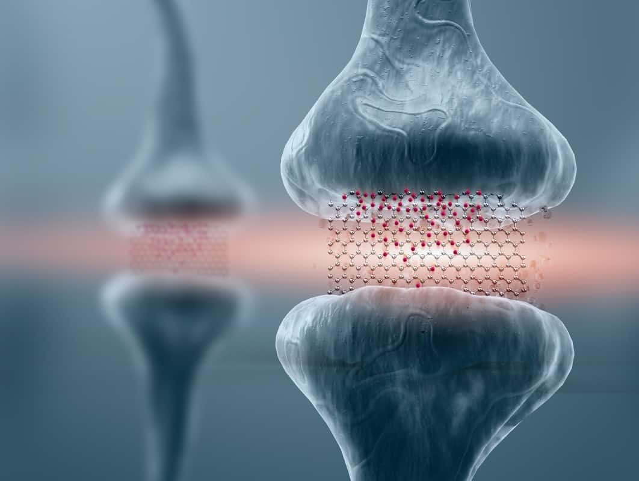
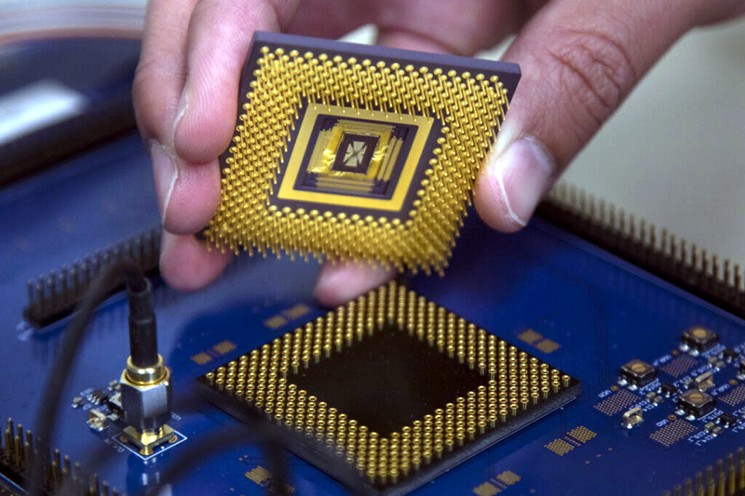
Future Scope and Implementation
The further steps includes the integration of AI Models with advanced quantum algorithms and real time implementation of the developed prototype in Quantum Systems and Processors.
On a Hardware scale, we plan on bringing in the Quantum – AI Memristors (Memory registors) into use for the intelligent optimization of storage capability.
Notes:
https://hackaday.com/wp-content/uploads/2019/07/memchip.png?w=800
https://physicsworld.com/wp-content/uploads/2020/11/Sam-Jarman-16-Nov-2020-memristor.jpg

Slide 8
Future Scope and Implementation
On a Software end we plan on extending the Quantum AI model with quantum annealing using d wave systems for processing diverse combinatorial dataset.
We intend on implementing the Shor’s algorithms into the muti-model frame to magnify the water potability properties and sync it to a neural regression.
We plan on the manipulation of IC Chips into the neural chips for intelligent selection of data modules and conversion of those models into threads for qubit encoding.
This would enable us to extend our limitations not only to the water challenges but for optimizing the utilization of other natural resources too.

Slide 9

A picture is worth a thousand words

